Slide 1
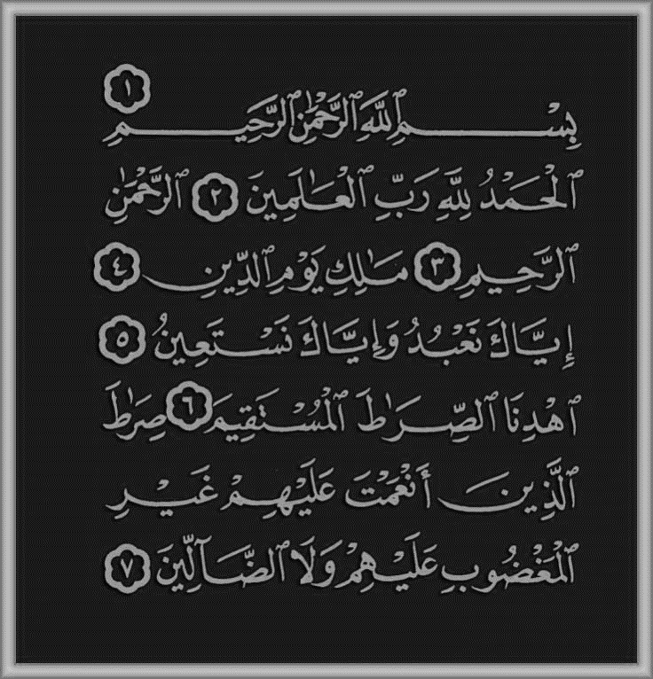
In the name of Allah, the Beneficent, the Merciful

Slide 2
Sayyidina Imam al-Hasan and Sayyidina Imam al-Husayn (Rady Allahu ‘Anhuma)
Ovais Ahmad
Madrasa al-Hidaya
Date: Ramadan 1436/ June 2015

Slide 3
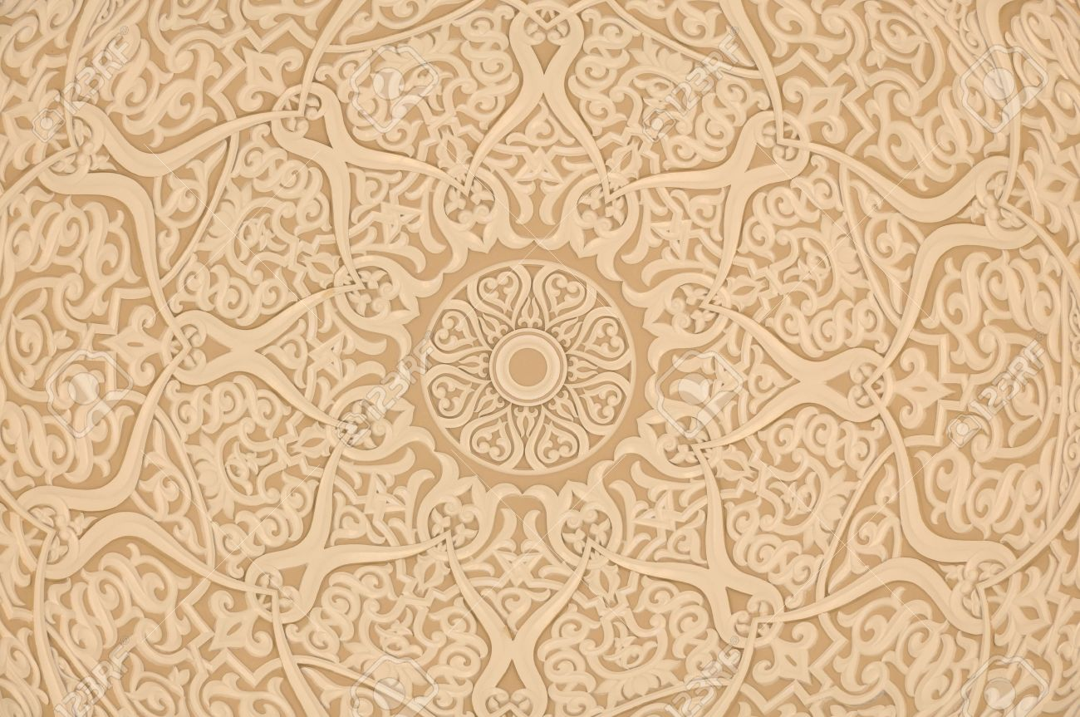
Table of Content
Introduction
Sayyidina Imam al-Hasan (Rady Allāhu ‘Anhu)
Sayyidina Imam al-Husayn (Rady Allāhu ‘Anhu)
The Birth
Part of the Ahl-al-Bayt (The Prophet’s Family)
Titles of both Sayyidina Imam al-Hasan and Imam al-Husayn (Rady Allāhu ‘Anhuma)
Holy Prophet’s (s.a.w) love for Imam al-Hasan (Rady Allāhu ‘Anhu)
Imam al-Hasan’s (Rady Allāhu ‘Anhu) time as Khalifah
The passing ahead of Imam al-Hasan (Rady Allāhu ‘Anhu)
Date: Ramadan 1436/ June 2015

Slide 4
Table of Content (Continued)
Holy Prophet’s (s.a.w) love for Imam al-Husayn (Rady Allāhu ‘Anhu)
Imam al-Husayn (Rady Allāhu ‘Anhu) and the Battle of Kerbala
Wisdom and Courage of Imam al-Husayn (Rady Allāhu ‘Anhu)
Example and Lesson of Imam al-Husayn (Rady Allāhu ‘Anhu)
Tribute to Imam al-Husayn (Rady Allāhu ‘Anhu)
Sources
Al-Fatihā
Date: Ramadan 1436/ June 2015

Slide 5
Introduction of Sayyidina Imam Hasan ibn ‘Ali (Rady Allāhu ‘Anhu)
Imam al-Hasan (Rady Allāhu ‘Anhu) was born in 3 A.H
He is the grandson of the Holy Prophet (s.a.w)
He is the elder son of Sayyidina Ali (Rady Allāhu ‘Anhu) and Sayyidatina Fatima (Rady Allāhu ‘Anha)
His name was chosen by the Holy Prophet (s.a.w)
He was the fifth Khalifah
He is a “Sahabi,” a Companion of the Holy Prophet (s.a.w)

Slide 6
Introduction of Sayyidina Imam Husayn ibn ‘Ali (Rady Allāhu ‘Anhu)
He is the grandson of the Holy Prophet (s.a.w)
He is the second son of Sayyidina Ali and Sayyadatina Fatima (Rady Allāhu ‘Anhum)
Imam al-Husayn (Rady Allāhu ‘Anhu) was born in 4 A.H
His name was chosen by the Holy Prophet (s.a.w)
He is a “Sahabi,” a Companion of the Holy Prophet (s.a.w)
He was given the title of
Sayyid u’sh Shuhada which means the Leader of Martyrs
Notes:
Sayyid u’sh Shuhada which means Leader of Martyrs is in reference to the Battle of Kerbala, where Iman al-Husuyn showed resounding courage and resolve.

Slide 7
The birth of Imam al-Husayn (Rady Allāhu ‘Anhu)
Imam al-Husayn (Rady Allāhu ‘Anhu) was born on the 4th of Shaban in Madinatul-Munawwarah
Upon his birth, the Holy Prophet (s.a.w) recited the adhan in his right ear, and the iqamah in his left ear.
Notes:
http://www.minhaj.org/english/tid/432/Blessed-Imam-Husayn-article-by:-Muhammad-Hanif.html

Slide 8
Part of the Ahl-al-Bayt
The Ahl-al-Bayt is the Family of the Holy Prophet (s.a.w).
It is narrated that Iman al-Hasan and Imam al-Husayn are from the Ahl-al-Bayt alongside Sayyidina Ali and Sayyidatina Fatima (Rady Allāhu ‘Anhum)
In regards to the Ahl-al-Bayt, this verse in the Holy Qur’an was revealed:
“Allah only desires to keep away the uncleanness from you O people of the House, and to purify you a thorough purifying.” (33:33)
The love for the Ahl-al-Bayt is shown by the Holy Prophet (s.a.w) when he looked towards them and then said, "I am at war with those who will fight you, and at peace with those who make peace with you."
(Tirmidhi)
Notes:
http://www.minhaj.org/english/tid/432/Blessed-Imam-Husayn-article-by:-Muhammad-Hanif.html
Key to Islam

Slide 9
Titles of Imam al-Hasan and Imam al-Husayn (Rady Allāhu ‘Anhuma)
The Holy Prophet (s.a.w) called them
his “two sweet smelling flowers in this world.”
The Holy Prophet (s.a.w) said
“these two sons of mine are the leaders of the youth in Paradise.”
as-Sayyid
which means a descendant of the Prophet (s.a.w)
Shahid (martyr)
Muneer (shining)
Zahir (brilliant)
Tayyib (agreeable)
Tahir (pure)
Saeed (blessed)
Notes:
http://www.alahazrat.net/islam/excellence-gems-of-wisdom-by-hasnain-kareemain.php
as referenced in [Sunan al-Tirmidhi, Kitab al-Manaqib, Manaqib Abi Muhammad al-Hasan, Hadith no. 3793, Vol. 5, Page 426].
as referenced in [Sunan al-Tirmidhi, Hadith no. 3800, Vol. 5, Page 429].
http://www.minhaj.org/english/tid/432/Blessed-Imam-Husayn-article-by:-Muhammad-Hanif.html
Key to Islam

Slide 10
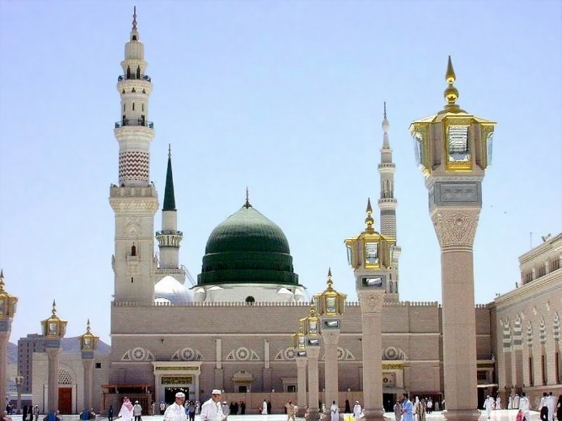
Holy Prophet’s (s.a.w) love for Imam al-Hasan(Rady Allāhu ‘Anhu)
The Holy Prophet (s.a.w) use to carry Imam al-Hasan (Rady Allāhu ‘Anhu) on his shoulder during his childhood, and prayed to Allah (s.w.t) “ I love him, so please love him.”
Once when the Holy Prophet (s.a.w) was in sajdah, Imam al-Hasan (Rady Allāhu ‘Anhu) wrapped himself around the blessed back of the Holy Prophet (s.a.w).
Thus, the Holy Prophet (s.a.w) prolonged the prostration so that he would not fall when the Holy Prophet (s.a.w) raised his head.
Notes:
As Referenced in [Sunan al-Tirmidhi, Kitab al-Manaqib, Manaqib Abi Muhammad al-Hasan – Hadith no. 3809, Vol 5, Page 432].

Slide 11
Holy Prophet’s (s.a.w) love for Imam al-Hasan(Rady Allāhu ‘Anhu)
It is narrated that, Imam al-Hasan (Rady Allāhu ‘Anhu) climbed on to the shoulders of the Holy Prophet (s.a.w).
A person remarked, “O blessed son! What a nice steed you have.” In reply, the Holy Prophet declared, “ And how nice a rider too.”
Notes:
As Referenced in [Sunan al-Tirmidhi, Kitab al-Manaqib, Manaqib Abi Muhammad al-Hasan – Hadith no. 3809, Vol 5, Page 432].

Slide 12
Imam al-Hasan’s(Rady Allāhu ‘Anhu) time as Khalifah
After the passing ahead of his father Sayyidina Ali, Imam al-Hasan (Rady Allāhu ‘Anhu) was chosen to be the next Khalifah
Imam al-Hasan’s (Rady Allāhu ‘Anhu) time as Khalifah was short.
The Holy Prophet (s.a.w) had said that in the future, Iman al-Hasan (Rady Allāhu ‘Anhu) would unite two quarrelling factions of Muslims.
He did that during his time as Khalifah.
Notes:
As Referenced in [Sunan al-Tirmidhi, Kitab al-Manaqib, Manaqib Abi Muhammad al-Hasan – Hadith no. 3809, Vol 5, Page 432].

Slide 13
Imam al-Hasan’s(Rady Allāhu ‘Anhu) time as Khalifah
During Imam al-Hasan’s (Rady Allāhu ‘Anhu) time as Khalifah, the rebel armies of Muawiya were advancing against the Imam.
Imam al-Hasan (Rady Allāhu ‘Anhu) understood the tremendous loss of blood between the two parties if a battle had ensued.
Thus, to save Muslim lives and prevent innocent bloodshed, Imam al-Hasan (Rady Allāhu ‘Anhu) had negotiated with Muawiya to step down as Khalifah and entrust it to Muawiya till his passing ahead.
Date: Ramadan 1436/ June 2015

Slide 14
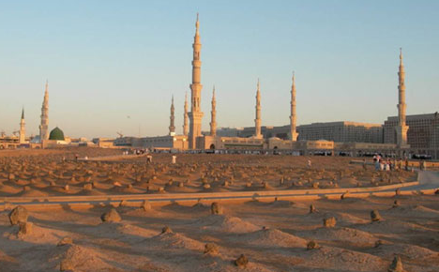
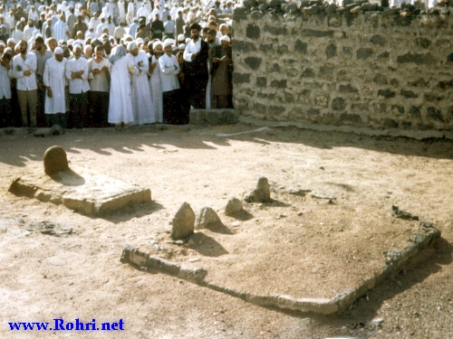
Passing Ahead of Imam al-Hasan (Rady Allāhu ‘Anhu)
Imam al-Hasan (Rady Allāhu ‘Anhu) had passed ahead in 50 A.H
He had been murdered as he was poisoned
He was buried in Janaat ul Baqi near his mother Sayyidatina Fatima (Rady Allāhu ‘Anha)

Slide 15
Holy Prophet’s (s.a.w) love for Imam al-Husayn(Rady Allāhu ‘Anhu)
Once Sayyidina Ali (Rady Allāhu ‘Anhu) saw that the Holy Prophet (s.a.w) was crying.
When he asked him as to what made him cry, he replied, "O Ali, Jibril (alayhissalam) has just been with me and informed me that my son Husayn would be martyred in Kerbala. This moved me so much that I could not help weeping."
The Holy Prophet (s.a.w) once said, "He who loved Hasan and Husayn loved me, and he who hated them hated me."
Holy Prophet (s.a.w) said, “Husayn is from me and I am from Husayn. May Allah (s.w.t) keep him as a friend who keeps Husayn as his friend.”"
Notes:
http://www.minhaj.org/english/tid/432/Blessed-Imam-Husayn-article-by:-Muhammad-Hanif.html
As Referenced in Musnad Ahmad bin Hambal, volume 2, page 288
As Referenced in Musnad Ahmad Ibn Hambal, volume 4, page 172
As Referenced in Al-Khasis-ul-Kubra, volume 2, page 12

Slide 16
Miracles of Imam al-Husayn(Rady Allāhu ‘Anhu)
Miraculous water
Imam al-Husayn (Rady Allāhu ‘Anhu) was requested by someone to make dua for their well as there was a scarce amount of water in it.
The Imam drank some water from the well in a bucket, and then poured the rest of water in the bucket back into the well.
Miraculously, the water welled up substantially, and became sweeter and much more pleasant than before
Radiating Light
It is stated that, whenever Imam Husayn (Rady Allāhu Anhu) would stay in the dark, his surrounding area would become illuminated by refulgent beams radiating from his blessed forehead and cheeks.
Notes:
http://data2.dawateislami.net/Data/Books/Download/en/pdf/2010/193-1.pdf
As referenced in (Shawāĥid-un-Nubūwwaĥ, p. 228)
As Referenced in (Al-Ṭabqāt-ul-Kubrā, pp. 110, vol. 5)

Slide 17
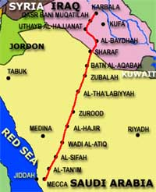
Imam al-Husayn(Rady Allāhu ‘Anhu) and the Battle of Kerbala
After the passing ahead of Imam al-Hasan (Rady Allāhu ‘Anhu), Yazid came into power and brought hardship towards the Muslim people
Imam al-Husayn (Rady Allāhu ‘Anhu) received countless letters from people to end the horrible conditions Yazid brought.
Yazid demanded the Imam and his followers to acknowledge him as their leader, which they would never do, as Yazid was a sinner and a tyrant.
When the Imam could not reach any peaceful resolution, he was forced to fight against Yazid’s huge army.

Slide 18
Wisdom and Courage of Imam al-Husayn(Rady Allāhu ‘Anhu)
Despite knowing the multiple disadvantages Imam al-Husayn (Rady Allāhu ‘Anhu) and his followers faced Yazid’s army head on.
He had the wisdom to recognize the vast spread of destruction that Yazid’s corruption would bring for the community and the future.
Alongside his followers, he felt the need and religious duty to stop him as he did not follow Allah’s Commands.

Slide 19
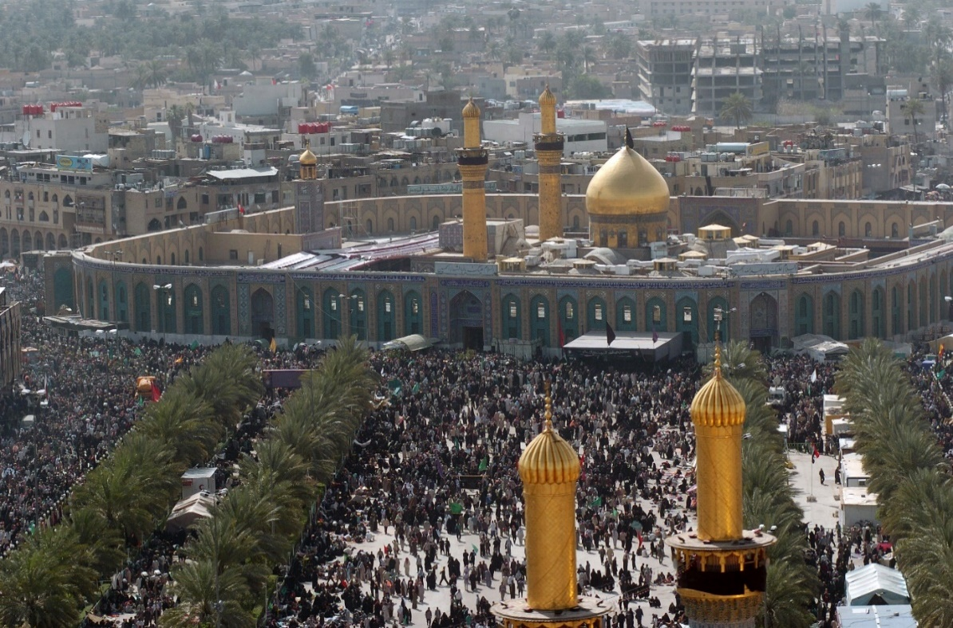
Martyrdom of Imam al-Husayn(Rady Allāhu ‘Anhu)
Imam al-Husayn (Rady Allāhu ‘Anhu) , his family and followers showed immense courage and engaged in the battle despite multiple obstacles:
No water
Witnessing the death of close ones
Numerical disadvantage
Betrayal
Alongside his followers and army, Imam al-Husayn (Rady Allāhu ‘Anhu) was martyred on the 10th of Muharram 61 A.H in Kerbala
He was laid to rest in Kerbala.
Notes:
Army of 72 – (32 Horsemen and 40 foot soldiers

Slide 20
Lesson and Example of Imam al-Husayn(Rady Allāhu ‘Anhu)
Imam al-Husayn’s (Rady Allāhu ‘Anhu) martyrdom and act of courage teaches all Muslims about selflessness, and sacrifice in the way of Allah.
He set an example showing us that we should never waver in Faith and in following the Command of Allah
He showed us the importance to stand up for justice and the truth.

Slide 21
Tribute to Imam al-Husayn (Rady Allāhu ‘Anhu)
Sufi saint Hazrat Khwaja Gharib Nawaz, Mawlana Mu‘inuddin Hasan Chishti (Rahamtullahu ‘alayh), a descendant of the Ahl-al-Bayt, paid tribute to
Imam al-Husayn (Rady Allāhu ‘Anhu). It’s translation is:
“He gave his head but did not put his hand into the hands of Yazid. Verily, Husayn is the foundation of la ilaha Illallah (there is no deity except Allah). Husayn himself is Islam and the shield of Islam.”
Notes:
http://www.madrasahidaya.net/Khwaja%20Gharib%20NawazMaulana%20Muhinudeen%20Chishti.html
http://www.minhaj.org/english/tid/432/Blessed-Imam-Husayn-article-by:-Muhammad-Hanif.html

Slide 22
Sources
Madrasa Hidaya (madrasahidaya.net)
http://www.madrasahidaya.net/KeyToIslamContentssecondedition.html
http://www.madrasahidaya.net/Khwaja%20Gharib%20NawazMaulana%20Muhinudeen%20Chishti.html
Iqra (iqra.net)
http://www.iqra.net/articles/muslims/family3.php
http://www.iqra.net/muslimstudents/seniorsessay3.html
International Islamic website (alahazrat.net)
http://www.alahazrat.net/islam/excellence-gems-of-wisdom-by-hasnain-kareemain.php
Date: Ramadan 1436/ June 2015

Slide 23
Sources
Dawat-e-Islami(dawateislami.net)
http://data2.dawateislami.net/Data/Books/Download/en/pdf/2010/193-1.pdf
Minhaj ul Quran (minhaj.org)
http://www.minhaj.org/english/tid/432/Blessed-Imam-Husayn-article-by:-Muhammad-Hanif.html
The Canadian Society of Muslims (muslimcanada.org)
http://muslimcanada.org/martyr2.pdf
http://muslimcanada.org/martyr.pdf

Slide 24
Al-Fatihā
Date: Ramadan 1436/ June 2015

