Slide 1


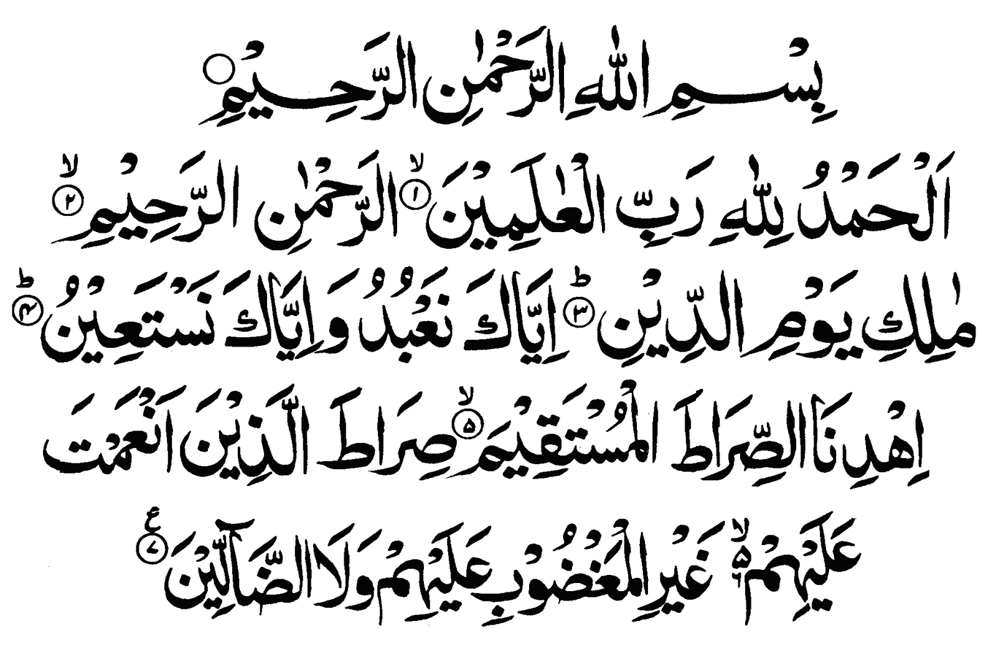

Slide 2
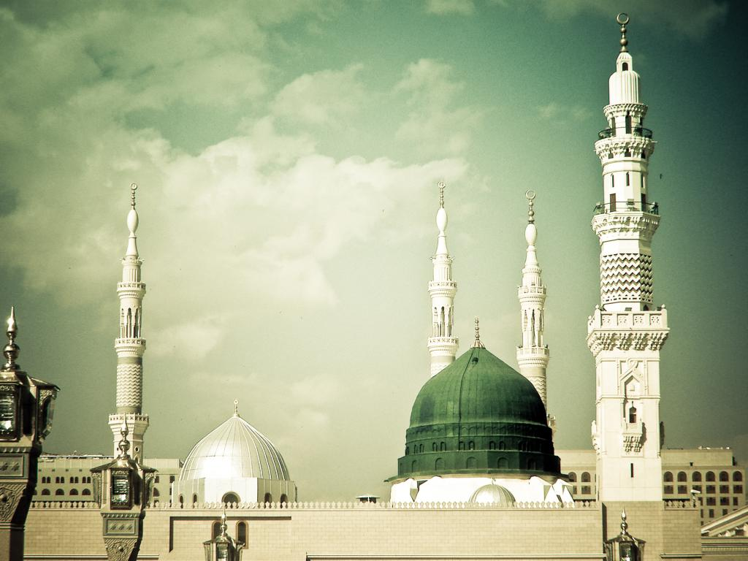
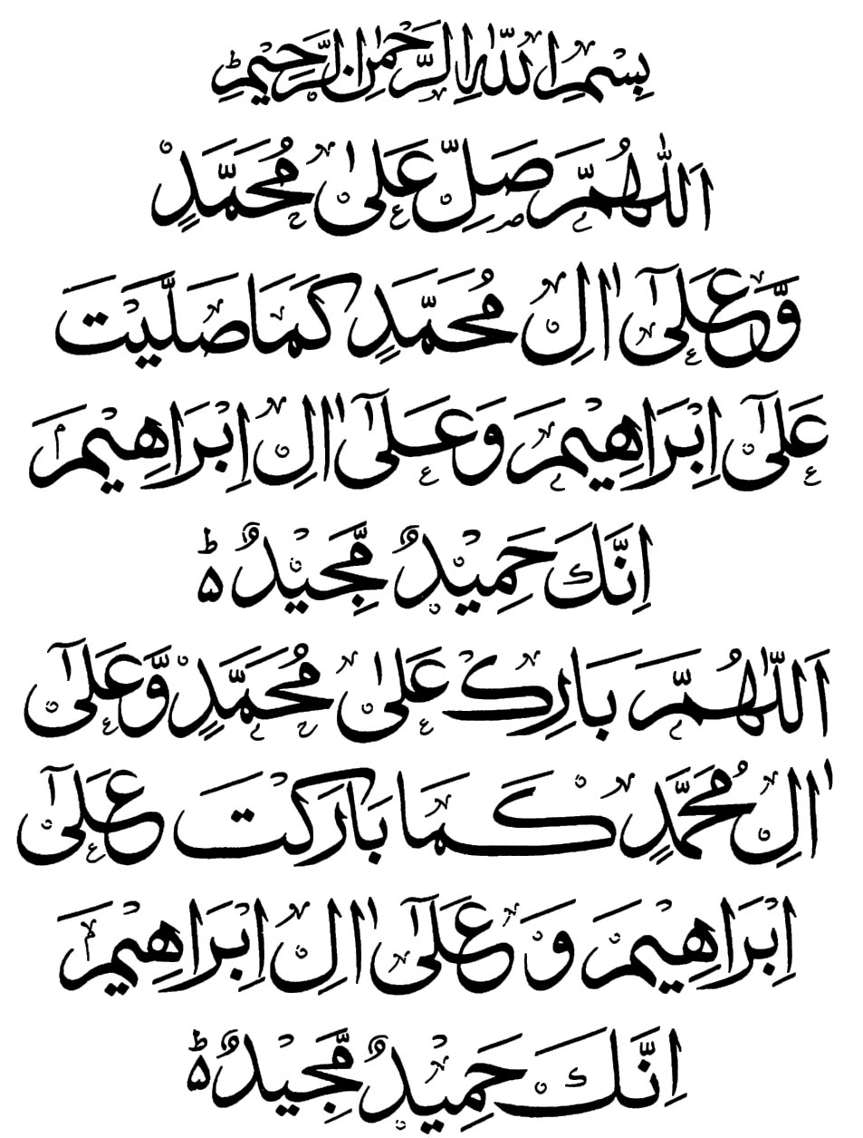

Slide 3

SAYYIDINA
ALI
AL-MURTADA
رضي الله عنه
ALI AHMAD MADRASA AL-HIDAYA MARCH 2016

Slide 4
Contents
Introduction
His Titles
Birth
Childhood
Marriage and Family
Love for Allah
سبحانه و تعالى and the Holy Prophet صلی اللہ علیہ وسلم
Devotion to Islam
His Strength & Courage
His Knowledge
His Spiritual Attainment
Faith in The Holy Prophet صلی اللہ علیہ وسلم
Relationship with the Sahaba
Special Honour
Martyrdom
Selected Quotes
Tribute
Sources
Dua

Slide 5
Introduction
Sayyidina Ali رضي الله عنه is the first cousin of the Holy Prophet صلى الله عليه و سلم
He is amongst the Ahl al Bayt, the Family of the Holy Prophet صلی اللہ علیہ وسلم
He is the son of Abu Talib (the Prophet’s paternal uncle) and Fatimah bint Asad.
He is the first child to have accepted Islam (at age 11)
He is the fourth Khalifa of Islam

Slide 6
His Titles
  Al-Murtada
    He with whom Allah سبحانه و تعالى is pleased
  Asadullah
    Lion of Allah
    (as he was brave and strong)
  Abu Turab
    Father of sand
    (as he slept on bare sand)
  Abul Hasan
    Father of Imam Hasan and Imam Husain
  Bab-ul-Ilm
    Gate of Knowledge

Slide 7
His Titles
  Shah-e-Awliya
    The king of saints
  Maula
    The master
  Al-Ghalib
    The dominant
  Sher-e-Yazdan
    The bravest man of age
  Mushkil Kusha
    One who resolves difficulties of people

Slide 8
His Titles
  Shah-e-Mominineen
    The king of the Faithful
  Amir ul-Mumineen
    Leader of the Faithful
  Amin ul Momineen
    Trustee of the Faithful
  Al-Zahid
    The Abstinent
  Haidar-e-Karrar
    The brave warrior against whom no one can stand

Slide 9
Birth
Sayyidina Ali رضي الله عنه was born on Friday, 13th of Rajab
His birth was special as he is the only person to have been born inside the Holy Ka'ba
Upon birth, his eyes first fell on the Holy Prophet صلی اللہ علیہ وسلم
His name was suggested by the Holy Prophet صلی اللہ علیہ وسلم

Slide 10
Childhood
Sayyidina Ali رضي الله عنه was raised in the home of the Holy Prophet صلی اللہ علیہ وسلم
He was the first child to accept Islam, at age 11.
He loved the Holy Prophet صلی اللہ علیہ وسلم and the Holy Prophet صلی اللہ علیہ وسلم loved him.
He received his training under the loving care and guidance of the Holy Prophet صلی اللہ علیہ وسلم

Slide 11
Marriage and Family
The Holy Prophet صلی اللہ علیہ وسلم was commanded by Allah
سبحانه و تعالى to give his daughter, Sayyidatina Fatima رضي الله عنها in marriage to Sayyidina Ali رضي الله عنه .
They had three sons
  Imam Hasan رضي الله عنه
  Imam Husain رضي الله عنه
  Muhsin (who passed ahead in infancy)
They had two daughters:
  Sayyidah Zainab رضي الله عنها
  Sayyidah Umm Kulthum رضي الله عنها
    She was given in marriage to Sayyidina Umar رضي الله عنه

Slide 12
Marriage and Family
The descendants of Holy Prophet صلی اللہ علیہ وسلم trace their lineage to Sayyidina Ali رضي الله عنه and Sayyidatina Fatima رضي الله عنها
Most sufi masters are also their descendants.

Slide 13
Marriage and Family
Once, Sayyidina Ali رضي الله عنه had an argument with Sayyidatina Fatima رضي الله عنها and left the home upset.
When the Holy Prophet صلی اللہ علیہ وسلم went to search for Sayyidina Ali رضي الله عنه, he found him sleeping in the sand.
The Holy Prophet صلی اللہ علیہ وسلم jokingly called him “abu turab,” which means “father of sand.”

Slide 14
Love for Allah سبحانه و تعالى and the Holy Prophet
صلی اللہ علیہ وسلم
The Holy Prophet صلی اللہ علیہ وسلم said that he would give the flag of the Battle of Khaybar to someone who loves Allah سبحانه و تعالى and His Prophet صلی اللہ علیہ وسلم the most, and whom Allah سبحانه و تعالى and His Prophet صلی اللہ علیہ وسلم love the most.
The Holy Prophet صلی اللہ علیہ وسلم gave the flag to Sayyidina Ali رضي الله عنه

Slide 15
Devotion to Islam
Sayyidina Ali رضي الله عنه was the only one from the relatives of the Holy Prophet
صلی اللہ علیہ وسلم to respond when he صلی اللہ علیہ وسلم asked who would help him in his Islamic mission.
Sayyidina Ali رضي الله عنه and Sayyidatina Khadija رضي الله عنها were the first two people to pray behind the Holy Prophet صلی اللہ علیہ وسلم

Slide 16
Devotion to Islam
The Holy Prophet صلی اللہ علیہ وسلم and Sayyidina Ali رضي الله عنه jointly sacrificed 100 camels when they went for Hajj.
After the conquest of Makkah, he had the unique distinction of standing on the shoulders of the Holy Prophet صلی اللہ علیہ وسلم and destroying the idols of the Holy Ka’ba.

Slide 17
His Strength & Courage
Sayyidina Ali رضي الله عنه was very strong, brave, and courageous.
He fought in many battles against the non-believers.
He fought in over a hundred duels, and always conquered.
He fought very bravely in the Battle of Uhud, and received many wounds
  The Holy Prophet صلی اللہ علیہ وسلم gave him the title of “Asadullah” meaning “Lion of Allah”

Slide 18
His Strength & Courage
Sayyidina Ali رضي الله عنه was appointed by the Holy Prophet صلی اللہ علیہ وسلم as his deputy in Madina during the Battle of Tabuk.
Sayyidina Ali رضي الله عنه asked the Holy Prophet صلی اللہ علیہ وسلم if he wanted to leave him with the women and children. The Holy Prophet
صلی اللہ علیہ وسلم replied that he was a brother to him, just like Nabi Harun عليه السلام was a brother to Nabi Musa عليه السلام, but there would be no prophet after him.

Slide 19
His Strength & Courage
Sayyidina Ali رضي الله عنه would always fight first in man-to-man combat.
  In the Battle of Badr
    He killed Al-Walid in a man-to-man combat
    He also killed over two dozen enemies
  In the Battle of Khaybar
    He killed Marhab, the best Jewish soldier, in a man-to-man fight

Slide 20
His Strength & Courage
He killed many enemy soldiers in battle.
His bravery has won him the titles
  Asadullah
    Lion of Allah
  Haidar-e-Karrar
    The warrior who nobody could match

Slide 21
His Knowledge
Sayyidina Ali رضي الله عنه was the most learned man of his age.
The Holy Prophet صلی اللہ علیہ وسلمsaid, “I am the city of knowledge and Ali is its gate”.
He has been titled “Bab ul-ilm” (the Gate of Knowledge).
He was a living encyclopedia of knowledge.

Slide 22
His Spiritual Attainment
Sayyidina Ali رضي الله عنه was the first person who memorized the Holy Qur’an by heart.
The Holy Prophet صلی اللہ علیہ وسلم said that one to whom he was a guardian, Sayyidina Ali رضي الله عنه was his guardian too.
He is regarded as “father of fiqh”
He is regarded as the “father of Sufism”
  Many schools of Tasawwuf (Sufism) trace their origin to him.

Slide 23
His Spiritual Attainment
There are at least 300 verses in the Holy Qur’an which have implied reference to Sayyidina Ali رضي الله عنه .
  Surah Al-Ahzab [verse 33]
    "Allah's wish is but to remove uncleanness far from you, O Folk of the Household, and cleanse you with a thorough cleansing.“
  Surah Ash-Shuraa [verse 23]
    "Say (O Muhammad to mankind): 'No reward do I ask of you for this except the love of those near of kin.' "

Slide 24
Faith in the Holy Prophet
صلی اللہ علیہ وسلم
When the non-believers of Makkah wanted to kill the Holy Prophet صلی اللہ علیہ وسلم he asked Sayyidina Ali رضي الله عنه to sleep in his bed that night.
  When the non-believers came to attack the Holy Prophet صلی اللہ علیہ وسلم, they found Sayyidina Ali instead, and left.
  When Sayyidina Ali رضي الله عنه was asked if he was scared that night, he said he was not worried at all because the Holy Prophet صلی اللہ علیہ وسلم told him he would meet him in Madina.
When the Holy Prophet صلی اللہ علیہ وسلم migrated to Madina, he paired himself, in brotherhood, with Sayyidina Ali رضي الله عنه

Slide 25
Relationship with Sahaba
As Khalifa, Sayyidina Abu Bakr رضي الله عنه used to consult Sayyidina Ali رضي الله عنه .
As Khalifa, Sayyidina Umarرضي الله عنه appointed Sayyidina Ali رضي الله عنه as Chief Justice.
  Sayyidina Ali was a just and fair judge
  Sayyidina Umar found Sayyidina Ali’s advice very valuable

Slide 26
Special Honour
Sayyidina Ali رضي الله عنه and Hadrat Abbas رضي الله عنه had the special honour to give ghusl to the Holy Prophet
صلی اللہ علیہ وسلم when he passed ahead.

Slide 27
Martyrdom
Sayyidina Ali رضي الله عنه was martyred, just as the Holy Prophet صلی اللہ علیہ وسلم had prophesized
  He was stabbed by an enemy with a poisonous sword, while he was going to the masjid to pray.
He passed ahead on the 21st of Ramadan, 40 A.H, at the age of 63.
His last resting place is in Najaf, Iraq.

Slide 28
Selected Quotes of
Sayyidina Ali رضي الله عنه
Fear Allah سبحانه و تعالى and you will have no cause to fear anyone.
Resignation to the Will of Allah سبحانه و تعالى is the cure for the disease of the heart.
The days of your life pass away like clouds, so do good while you are alive.
Patience is the fruit of Faith.
Forgiveness is the crown of greatness.
What you do not like for yourself, do not like it for others either.
Strengthen your heart with Faith.

Slide 29
Tribute to
Sayyidina Ali رضي الله عنه
Allama Iqbal, a famous Urdu poet, paid tribute to Sayyidina Ali in his poem, “Asrar-e-Khudi” which means “The Secrets of the Self” in the following words:
  Ali, the son-in-law of the Prophet was a man of many qualities.
  He gave fresh vigour to Faith.
  And brought honours to the community of the Faithful.
  He developed self-discipline and killed avarice.
  A person who knows and controls himself rules the world.

Slide 30
Sources
Madrasa Hidaya
  http://madrasahidaya.net/
Iqra Islamic Publications
  http://www.iqra.net/
The Canadian Society of Muslims
  http://muslimcanada.org/

Slide 31
Dua
May Allah سبحانه و تعالى enrich all of our hearts with immense love for Sayyidina Ali رضي الله عنه and guide us all on the Ṣirāṭ al-mustaqīm.
Ameen

