Slide 1
In the name of Allah, The most gracious, The most merciful, all praise is for Allah for the blessings he has bestowed upon us and may the peace and blessings of Allah be bestowed upon the beloved Prophet Muhammad (may the peace and blessings of allah be upon him)

Slide 2
Sayyidina Uthman Radhi Allahu ‘anhu
The Third Rightly Guided Khalifa
By Mustafa Khan
October 11th, 2017
20th Muharram, 1439 AH

Slide 3
Biographical Information

Slide 4
Sayyidina Uthman ibn ‘Affan al-Amawi (al-Makki, also later al-Madani), Abu Amr
Born in the city of Ta’if in the year 47 BH (576 CE) into the Umayyad clan of the Quraysh tribe of Makkah
Sayyidina Uthman (may Allah be pleased with him) was one of the earliest converts to Islam and converted after returning from a business trip to Syria in 611 CE. This occurred after a discussion with Sayyidina Abu Bakr (may Allah be pleased with him) who was the second person to accept Islam
Was called “Dhun-Nurayn” or “Possessor of the Two Lights” due to having married two of the daughters of the Messenger of Allah (may the peace and blessings of Allah be upon him)
Took part in both of the hijras (migrations). The first to Abyssinia and the second to Madinah
Participated in the Battle of Uhud in 3 AH (625 CE) and the Battle of the Trench in 5 AH (627 CE)
He was the third of the Khulafa Rashidun (Rightly Guided Khalifas)

Slide 5
Physical Characteristics
Sayyidina Uthman (may Allah be pleased with him) was of middle stature, not being short nor tall
He had a very beautiful face, so beautiful that Hazrat Musa Ibn Talhah (may Allah be pleased with him) said, “Uthman ibn Affan was the most beautiful of people”
He had a fair complexion with a shade of red. He had a full beard, was large limbed with hair covering his forearms
He had curly hair with yellow-coloured locks which fell behind his ears, but was also balding to his forehead, he also had very beautiful front teeth
He was said to have resembled both Prophet Muhammad (may the peace and blessings of Allah be upon him) and Prophet Ibrahim (peace be upon him)
Sayyidatina A’isha bint Abu Bakr (may Allah be pleased with her) said the Prophet (may Allah’s peace and blessings be upon him) told his daughter Sayyidatina Umm Kulthum (may Allah be pleased with her), “Your husband, of all men, is the one who most resembles your grandfather Ibrahim and your father Muhammad.”

Slide 6
Family
Sayyidina Uthman (may Allah be pleased with him) married the daughter of the Prophet, Sayyidatina Ruqayya (may Allah be pleased with her) in 7 BH (615 CE), who bore him a son; Abdullah ibn Uthman (may Allah be pleased with him)
After Sayyidatina Ruqayya (may Allah be pleased with her) passed ahead in 2 AH (624 CE), Sayyidina Uthman (may Allah be pleased with him) married another daughter of the Prophet, Sayyidatina Umm Kulthum (may Allah be pleased with her) in 3 AH (624 CE). She bore him no offspring
Sayyidina Uthman (may Allah be pleased with him) is the only man to have married two daughters of the Prophet (may Allah’s peace and blessings be upon him), thus giving him the title Dhun-Nurayn (Possessor of the two lights)

Slide 7
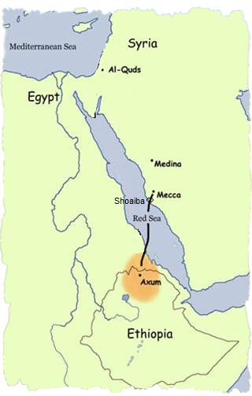
Migration to
Abyssinia
Due to extreme persecution from the Quraysh tribe of Makkah the Prophet (may the peace and blessings of Allah be upon him) ordered some of his Companions to migrate to Abyssinia and seek refuge in the Kingdom of the Negus
Sayyidina Uthman (may Allah be pleased with him) and his wife Sayyidatina Ruqayya (may Allah be pleased with her) were a part of the first group of emigrants who left in the year 7 BH (615 CE)

Slide 8
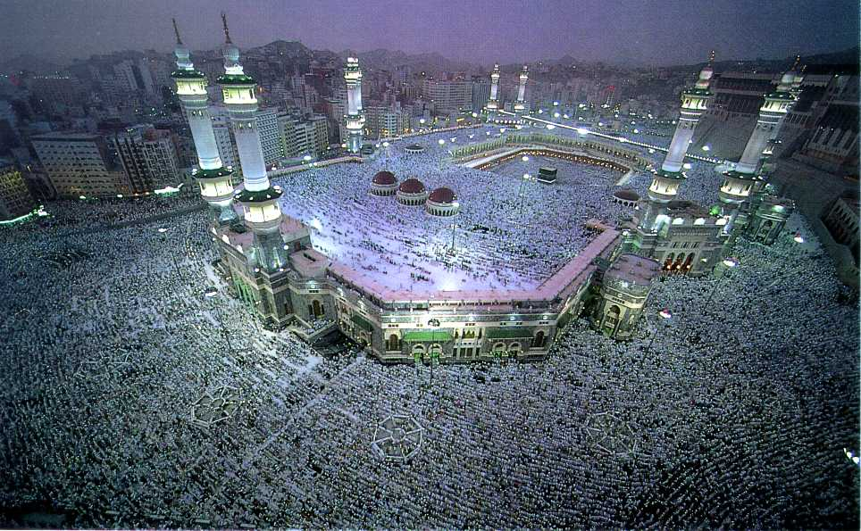
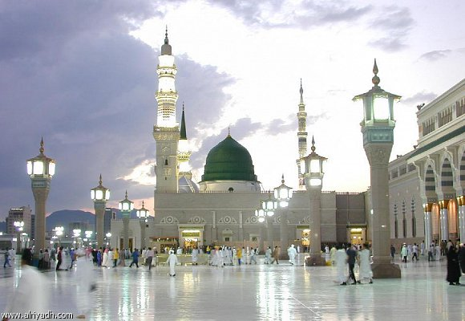
Migration to
Madinah and Life in Madinah
Sayyidina Uthman (may Allah be pleased with him) has the distinct honour of being a member of both the migration to Abyssinia and the migration to Madinah
He was a part of the third batch of migrants to Madinah in 622 CE along with his wife Sayyidatina Ruqayya (may Allah be pleased with her). On arrival he stayed in the house of an Ansari. After sometime he purchased a house of his own and moved there
Sayyidina Uthman (may Allah be pleased with him) was a very successful businessman, thus he was not in any need of financial aid. He quickly established himself as a trader in Madinah. Through hard and honest work his business flourished and he became one of the wealthiest men in Madinah

Slide 9
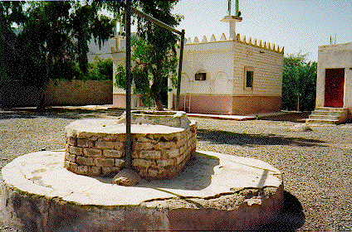
Life in Madinah - Role in easing the transition into Madinah
A problem that plagued the newly migrated Muslims in Madinah was the shortage of water. There was a well but it was held tightly under control by several men
Using his skills in trade and negotiation Sayyidina Uthman (may Allah be pleased with him) negotiated a price for half of a well
Sayyidina Uthman (may Allah be pleased with him) gave water to the Muslims for free. He eventually bought the well for a fair price. The well continued to be used for free by everyone
He also financed the construction of the Prophet’s Masjid in Madinah

Slide 10
His Khilafat

Slide 11
The Election
While the current Khalifa, Sayyidina ‘Umar (may Allah be pleased with him) lay on his deathbed, there was the dilemma of choosing a successor. He contemplated between nominating or not nominating his successor because the Prophet (may the peace and blessings of Allah be upon him) did not nominate a successor whereas Sayyidina Abu Bakr (may Allah be pleased with him) nominated a successor
Sayyidina ‘Umar (may Allah be pleased with him) eventually decided to make a committee of eligible candidates and then leave them to choose one of themselves
The committee consisted of Sayyidina ‘Ali ibn Abi Talib, Sayyidina ‘Uthman ibn ‘Affan, Hazrat Sa’d ibn Abi Waqqas, Hazrat Talha ibn ‘Ubaidullah, Hazrat Zubair ibn ‘Awwam, and Hazrat Abdur Rahman ibn ‘Awf (may Allah be pleased with them all)

Slide 12
The Election (continued)
When the committee was made, Hazrat Talhah (may Allah be pleased with him) was not in Madinah so the remaining members met to choose the new Khalifa. After many days of deliberation, on the fourth day after the passing ahead of Sayyidina ‘Umar (may Allah be pleased with him) the Muslims gathered in the Prophet’s masjid in Madinah
Hazrat Abdur Rahman ibn Awf (may Allah be pleased with him) spoke to the committee members recounting the process of electing a successor. Finally, the choice was between Sayyidina Ali and Sayyidina Uthman (may Allah be pleased with them both). He discussed the merits of both of them. After consulting the people it was seen that the majority of the committee were in favor of Sayyidina Uthman (may Allah be pleased with him) to be the successor
Hazrat Abdur Rahman ibn Awf (may Allah be pleased with him) then took the oath of allegiance to him as the Khalifa and then the rest of the commitee gathered in the masjid and also took the oath of allegiance

Slide 13
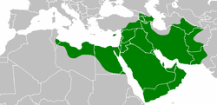
Military campaigns
Reconquering Alexandria
Conquest of North Africa
First Muslim campagin in Spain
Campaign in Nubia (Sudan)
Conquest of islands of the Mediterranean Sea
Defense of Syria against Byzantines
Re-conquest of Armenia and Georgia
Occupation of Anatolia (Asian part of Turkey)
Re-conquest of Fars (Iran)
Re-conquest of Sistan (Iran and Afghanistan)
Re-conquest of Tabaristan (Iran)
Re-conquest of Azerbaijan and Dagestan
Re-conquest of Khorasan (Iran, Afghanistan and Turkmenistan)
Campaign in Transoxiana (Uzbekistan, Tajikistan, southern Kyrgyzstan, southwest Kazakhstan)
Re-conquest of Makran (Pakistan)
Conquest of Baluchistan (Pakistan)
Campaign in Sindh (Pakistan)

Slide 14
Compilation of the Holy Qur’an
Sayyidina Uthman (may Allah be pleased with him) had the honourable privilege to compile the Holy Qur’an into a standard text and unite the Muslim community on a singular text for the rest of eternity
Since the Holy Qur’an was revealed to the Holy Prophet (may the peace and blessings of Allah be upon him) in parts over a period of twenty-three years, whenever a revelation was received it would be dictated to a scribe
After the Battle of Yamama where about 400 huffaz were martyred, the importance of having one standard copy of the Holy Qur’an was realized. There was one compilation produced after the battle, but many Muslims in different places such as Basra, Kufa, and Homs had different methods of reciting the Holy Qur’an

Slide 15
Compilation of the Holy Qur’an (continued)
In order to prevent a split amongst the people it was crucial that a standard copy be made. Sayyidina Uthman (may Allah be pleased with him) put together a committee comprising of Hazrat Zaid ibn Thabit, Hazrat Abdullah ibn Zubair, Hazrat Saeed bin Al Aas, and Hazrat Abdur Rahman bin Al-Harith (may Allah be pleased with them all)
Copies of the Holy Qur’an that were in use in various parts of the dominion were collected and compared with the copy in the custody of Sayyidatina Hafsa bint ‘Umar (may Allah be pleased with her)
Eventually all of the discrepancies between copies were fixed and an authorized standard edition was prepared and checked by Sayyidina Uthman (may Allah be pleased with him) and was approved
Copies of the new standard Mus’hafs were sent to all parts of the Muslim empire and all the previous copies were removed

Slide 16
Progress during the Khilafat
Under the khilafat of Sayyidina Uthman (may Allah be pleased with him) there were many advancements within society
He built many masaajid, schools, canals, and also organized the first navy in Islam
Sayyidina Uthman (may Allah be pleased with him) was loved very dearly and was always known for his generosity and fairness
He kept the welfare system that was established by Sayyidina ‘Umar (may Allah be pleased with him), this ensured that those who were less fortunate were taken care of
Sayyidina Uthman (may Allah be pleased with him) made sure that people with positions of power were serving people instead of exploiting them
He also ensured that the army followed the clear guidelines set down by his predecessors and asked them to never forget their duty of protecting the believers and Islam

Slide 17
Tensions within Madinah
Even after all of these achievements of Sayyidina Uthman (may Allah be pleased with him) some people were not happy and they wanted to remove him and they rebelled
Sayyidina Uthman (may Allah be pleased with him) did not want to quell these rebellions with his army because he did not want to shed any Muslim blood. He much prefered to reason with those who opposed him with kindness and generosity which is why the rebels believed they could succeed by taking advantage of his kindness and unwillingness to fight

Slide 18
Siege of Sayyidina Uthman
After a congregation in the masjid, Sayyidina Uthman (may Allah be pleased with him) gave a speech where he reassured the people of his intentions to aid them with their troubles. He instructed them to refrain from violence in order not to shed any Muslim blood
Even so, the rebels laid a siege to the house of Sayyidina Uthman (may Allah be pleased with him). They forbade the entry of food or provisions into the house. The house of Sayyidina Uthman (may Allah be pleased with him) was guarded by Sayyidina Hasan ibn Ali, Sayyidina Hussain ibn Ali, Hazrat Abdullah ibn Zubair, and a few other people (may Allah be pleased with them all)

Slide 19
His Martyrdom
The rebels eventually climbed over the walls and jumped onto the house
On the 18th of Muharram, 36 AH Sayyidina Uthman (may Allah be pleased with him) was fasting and the night before he dreamt of the Prophet (may the peace and blessings of Allah be upon him) who told him, "Be strong! Verily you shall break your fast with us tomorrow night." Sayyidina Uthman (may Allah be pleased with him) was in his quarters reciting from the Qu’ran when the rebels martyred him
He was laid to rest in Jannat-ul Baqi in Madinah

Slide 20
Spirituality
Sayyidina Uthman (may Allah be pleased with him) was one of the 10 men who were promised Jannah by Prophet Muhammad (may the peace and blessings of Allah be upon him)
Often, Sayyidina Uthman (may Allah be pleased with him) spent part of the night in prayer, he also fasted often throughout the year, performed Hajj every year, and always took care of those in need in the community
Even though he was wealthy, Sayyidina Uthman (may Allah be pleased with him) lived very simply
He had a deep love for the Qur’an, he frequently recited the Qur’an and had vast knowledge about the verses
His shyness caused the angels to also be shy in his presence

Slide 21
Selection of Hadiths regarding Sayyidina Uthman
The Prophet (may the peace and blessings of Allah be upon him) said, “Uthman's shyness causes the angels to be shy”
- Al-Tabarani
The Prophet (may the peace and blessings of Allah be upon him) said, “Every prophet has a friend in Paradise; my friend in it is Uthman”
- Ibn Majah
The Prophet (may the peace and blessings of Allah be upon him) said, “The intercession of Uthman shall cause to enter into Paradise, of my nation, more people than the tribe Tamim.”
- Tirmidhi
Sayyidina Ali (may Allah be pleased with him) said he heard the Prophet (may the peace and blessings of Allah be upon him) say to Sayyidina Uthman (may Allah be pleased with him), “If I had forty daughters I would get them married to you, one after the other (if they passed away) until there was none left.”
- Ibn ‘Asakir

Slide 22
References
Hilyat-ul-Awliya wa Tabaqat al-Asfiya
(The Beauty of the Righteous and the Ranks of the Elite)
By Abu Na`im al-Asfahani translated by Shaykh Muhammad Al-Akili
Pearl Publishing House, Philadelphia, Pennsylvania, 1995
“al-Khulafa ar-Rashidun” from Tarikh al-Khulafa
(The History of the Khalifahs who took the right way)
By Jalal ad-Din as-Suyuti translated by `Abdassamad Clarke
Ta-Ha Publishers Ltd. London, 1995

